Slide 1

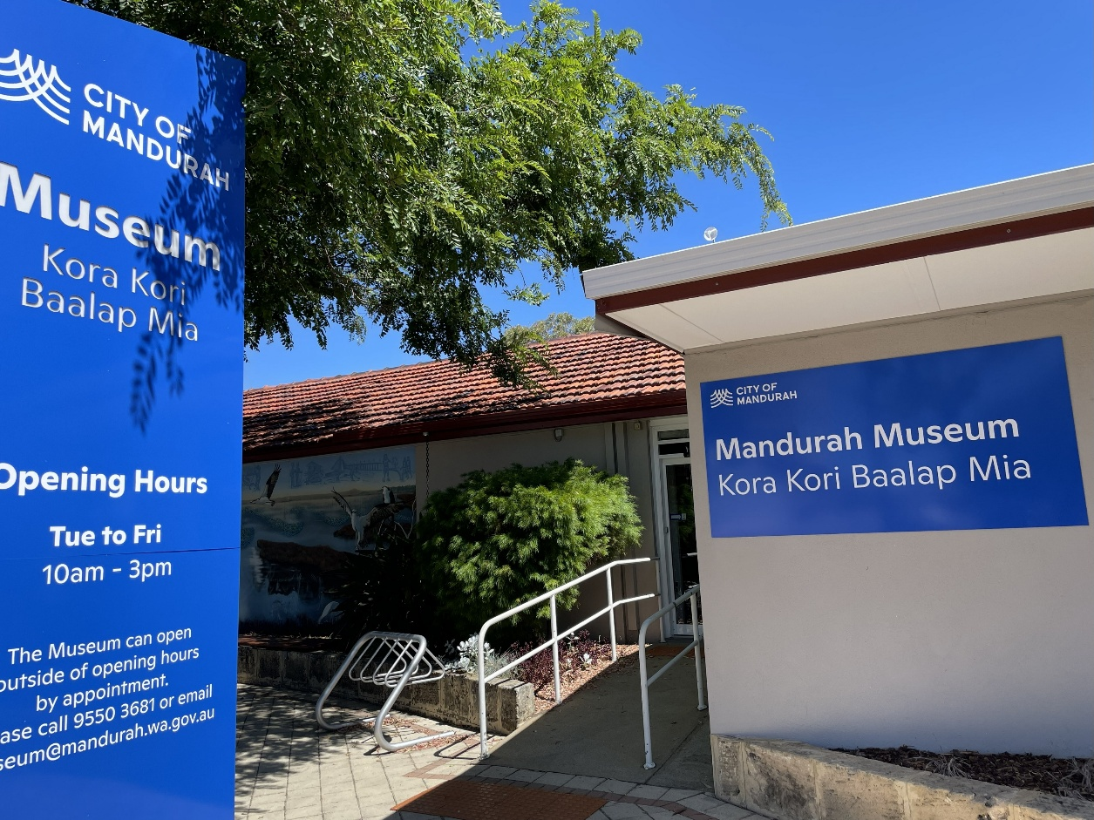

Visual Story
Visiting Mandurah Museum

Slide 2
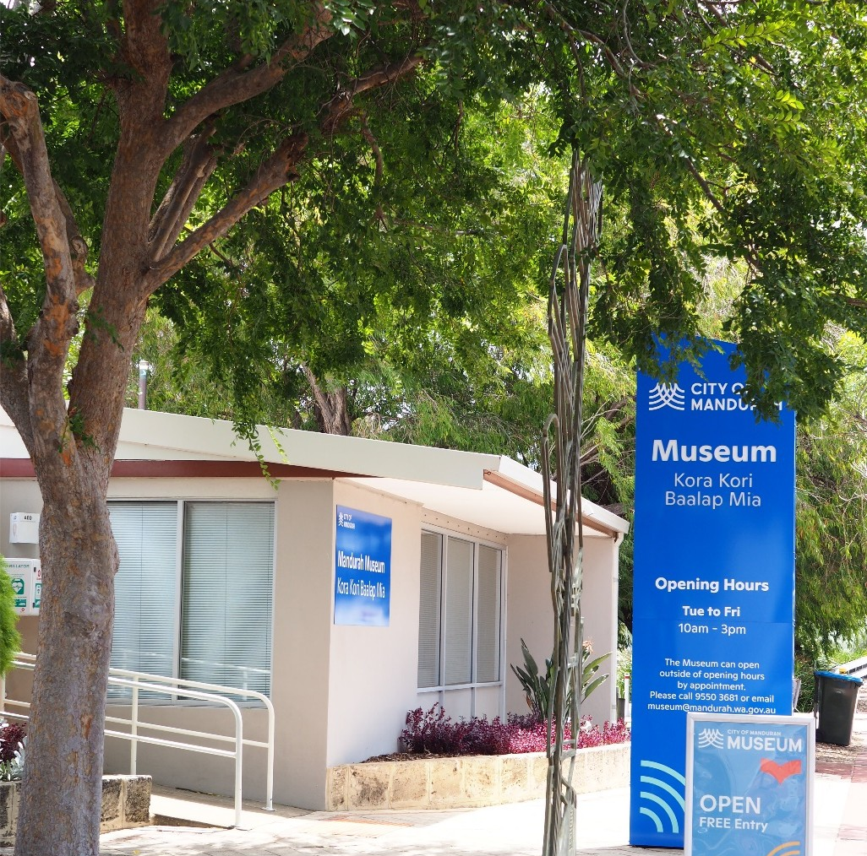
About this visual story
This visual story prepares me for a visit to Mandurah Museum. It explains what I will see and do, helping me feel ready and comfortable.
It is written in a clear and simple way for children, teenagers, or adults who like extra guidance and sensory support.

Slide 3
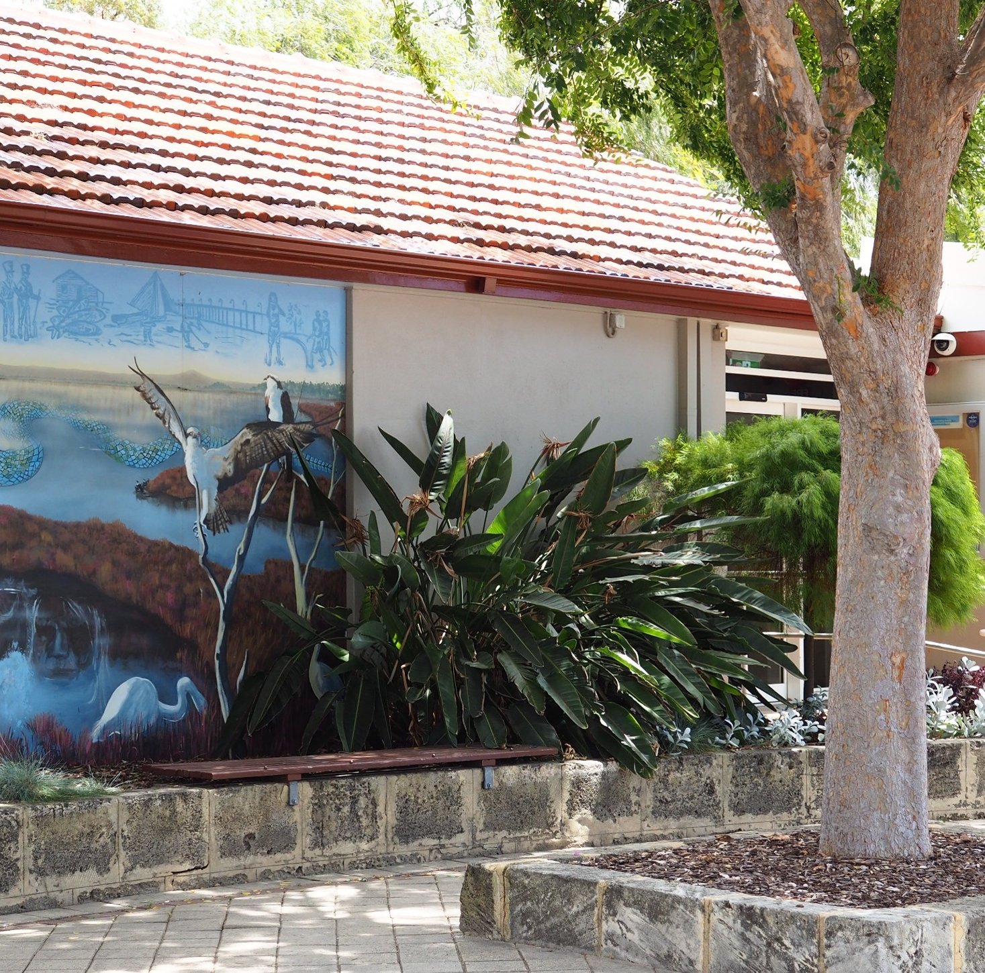
Venue
Mandurah Museum is at 3 Pinjarra Road, near the Mandurah Traffic Bridge.
The museum is open:
Tuesday–Friday, 10am–3pm.
Visiting the museum is free.

Slide 4
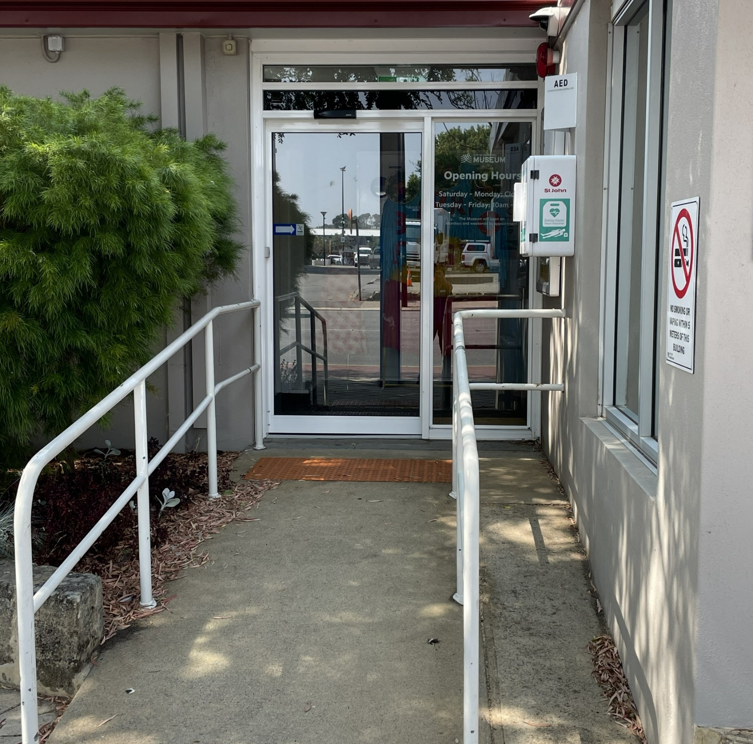
Getting to the museum
There is a carpark at the back of the museum.
The entrance is at the front of the building, facing Pinjarra Road. If I park at the back, I will walk to the front entrance.
When I arrive, I will see:
An accessible ramp
A glass front door that opens automatically

Slide 5
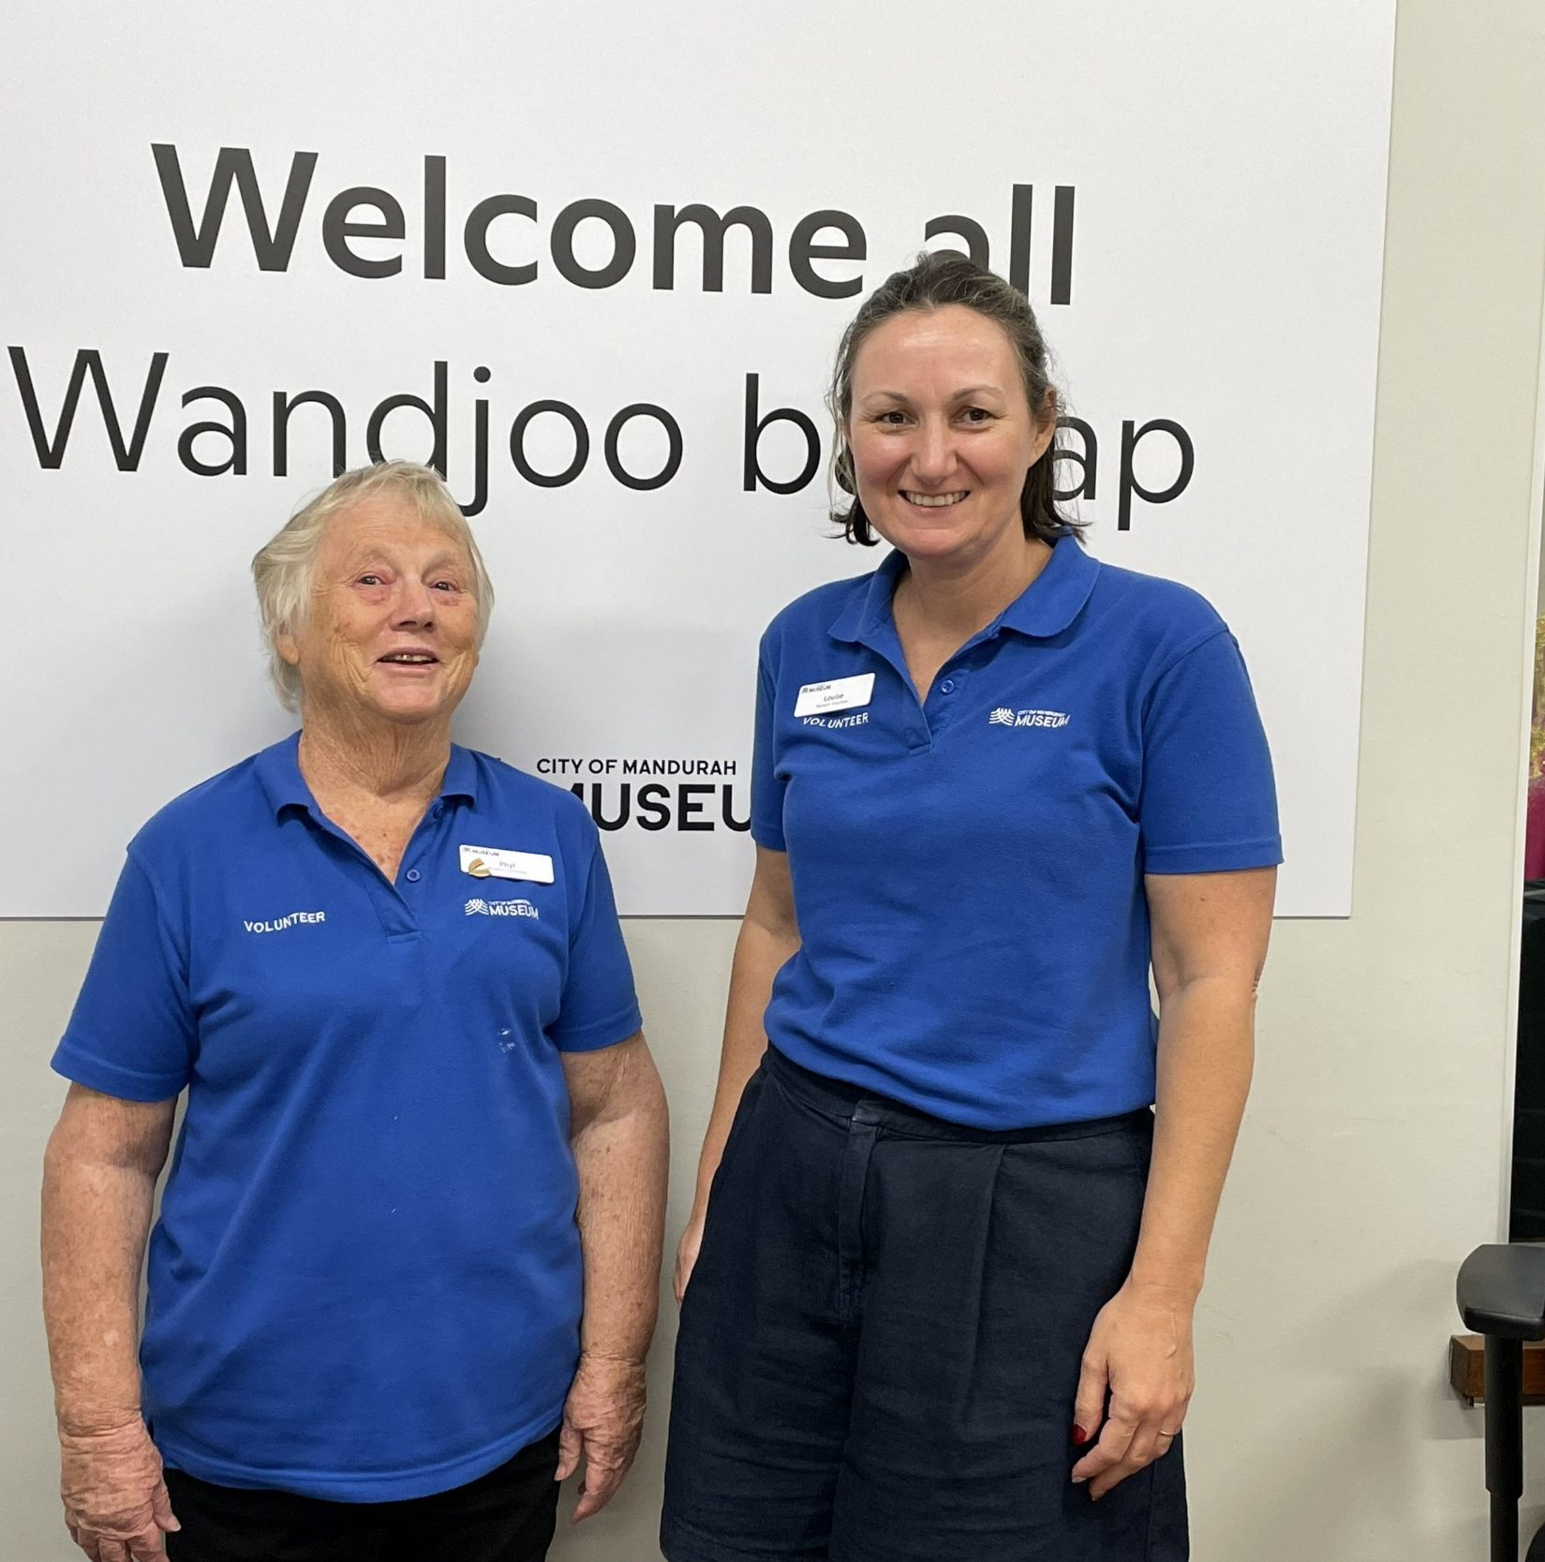
Entering the Museum
A staff member will greet me.
They wear:
• A blue shirt
• A name badge
They can help me if I have any questions.

Slide 6
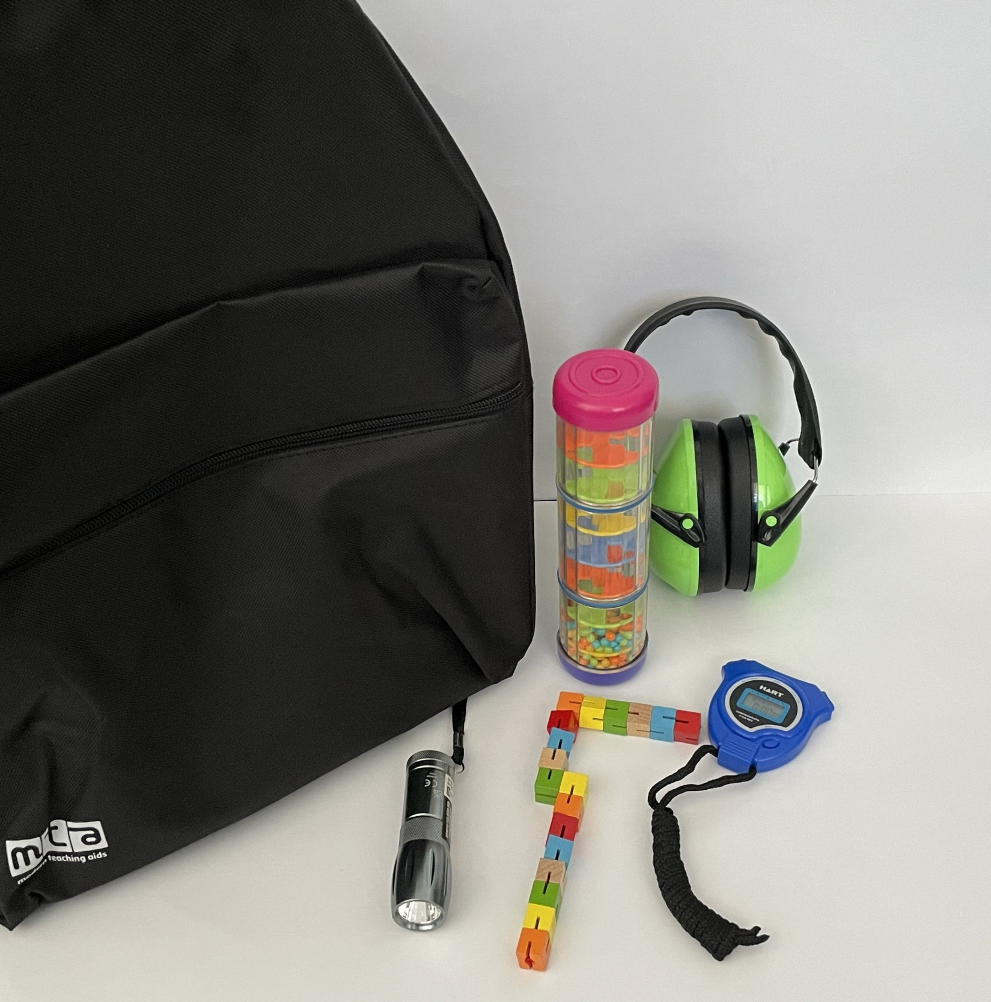
Sensory Backpacks
A sensory backpack is available for me to borrow.
They include helpful items like fidget tools, earmuffs and a sensory map.
I can ask a staff member for one and return it when I leave.

Slide 7
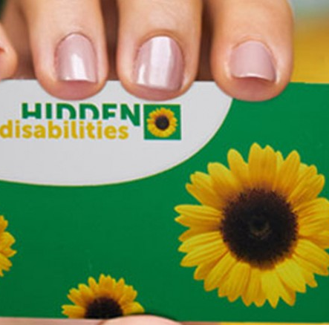
Hidden Disabilities Sunflower Lanyard Scheme
Staff wear sunflower lanyards to show they are happy to help.
I can borrow a lanyard from the front desk if I have a hidden disability.
I should return it when I leave.

Slide 8
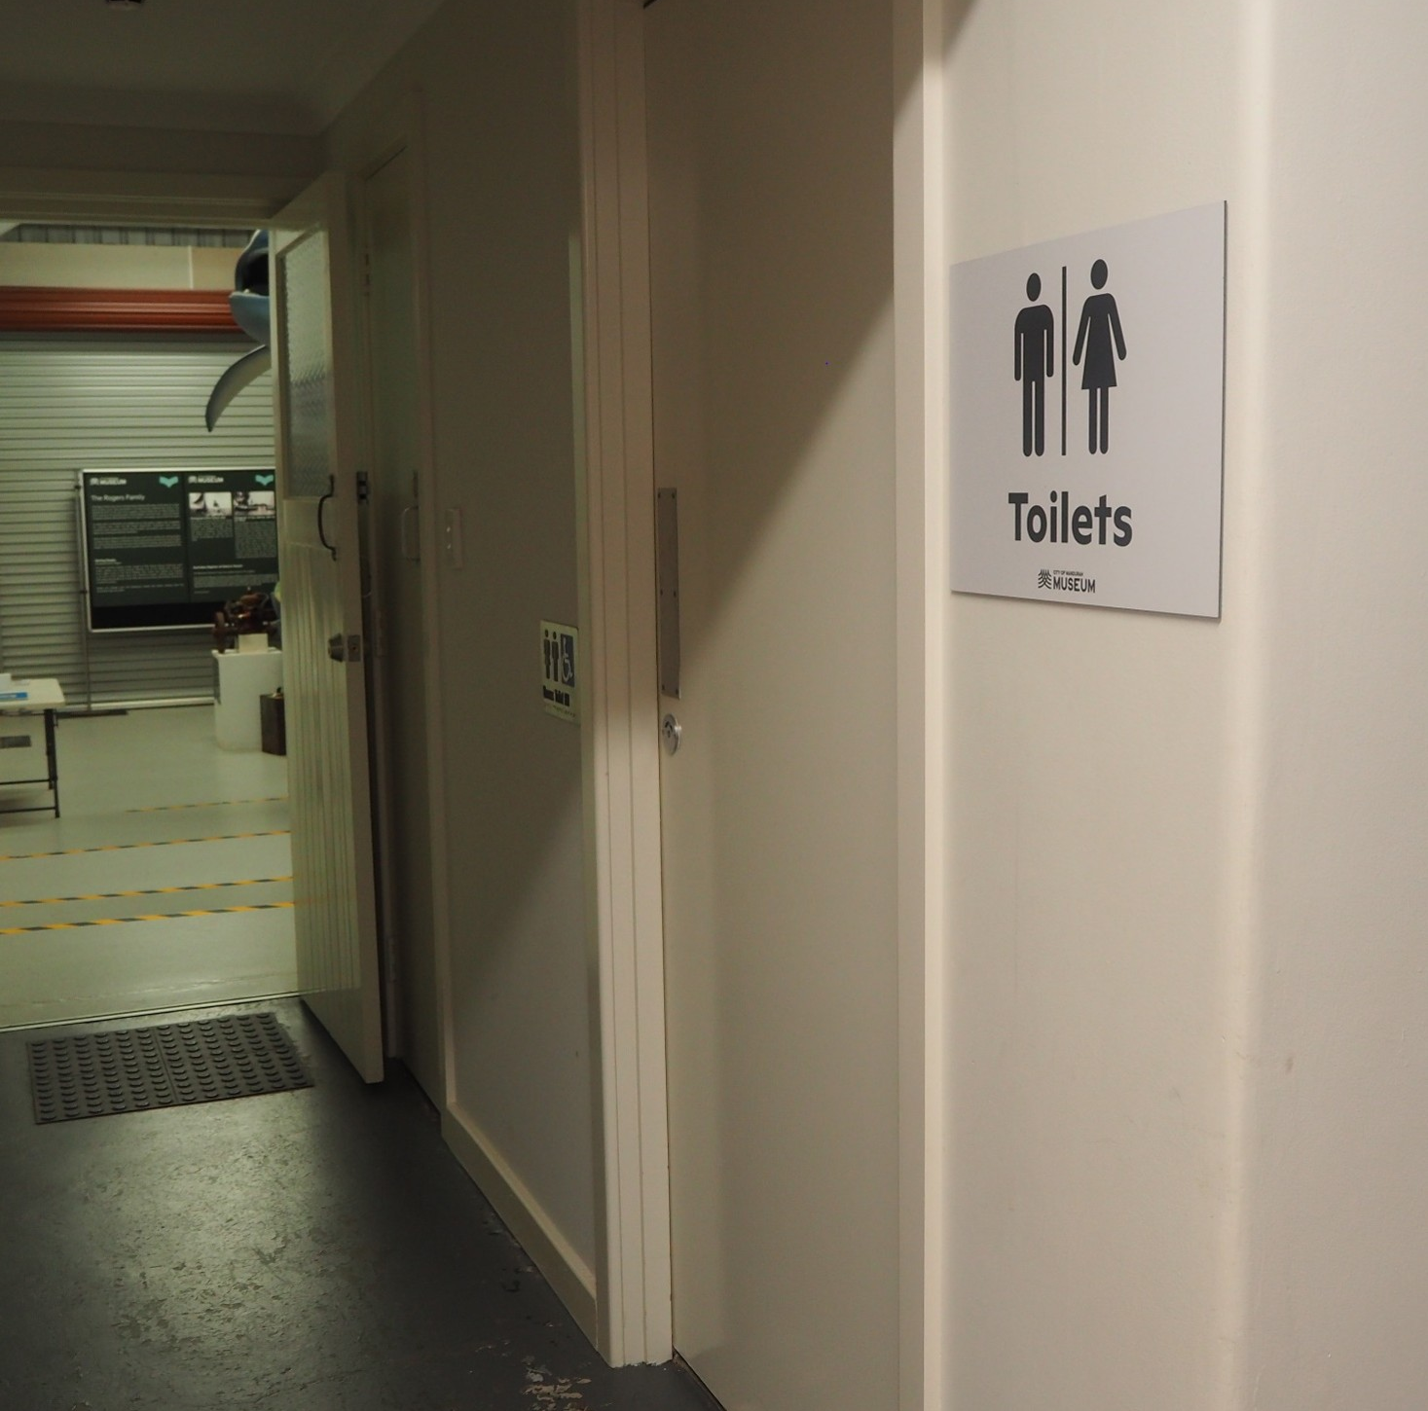
Toilets
The museum has one accessible toilet and one other toilet.
I can ask staff for directions.

Slide 9
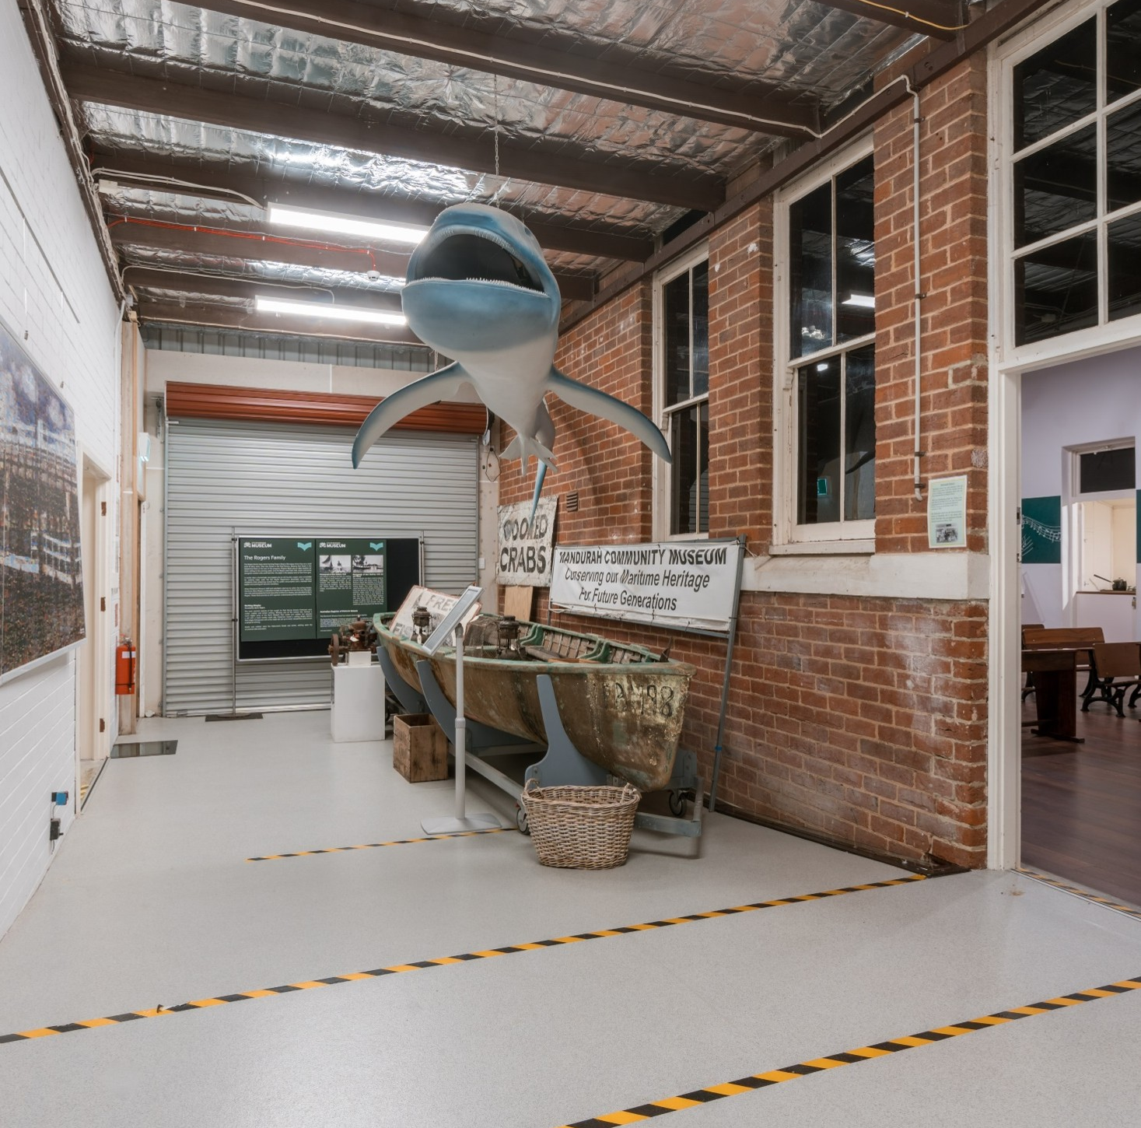
Exploring the museum
I can see objects, pictures, and hear sounds. These help me learn about Mandurah’s history.
Some areas might be dark.
Some may have steps or ramps.
I can stay safe by walking with my support person.

Slide 10
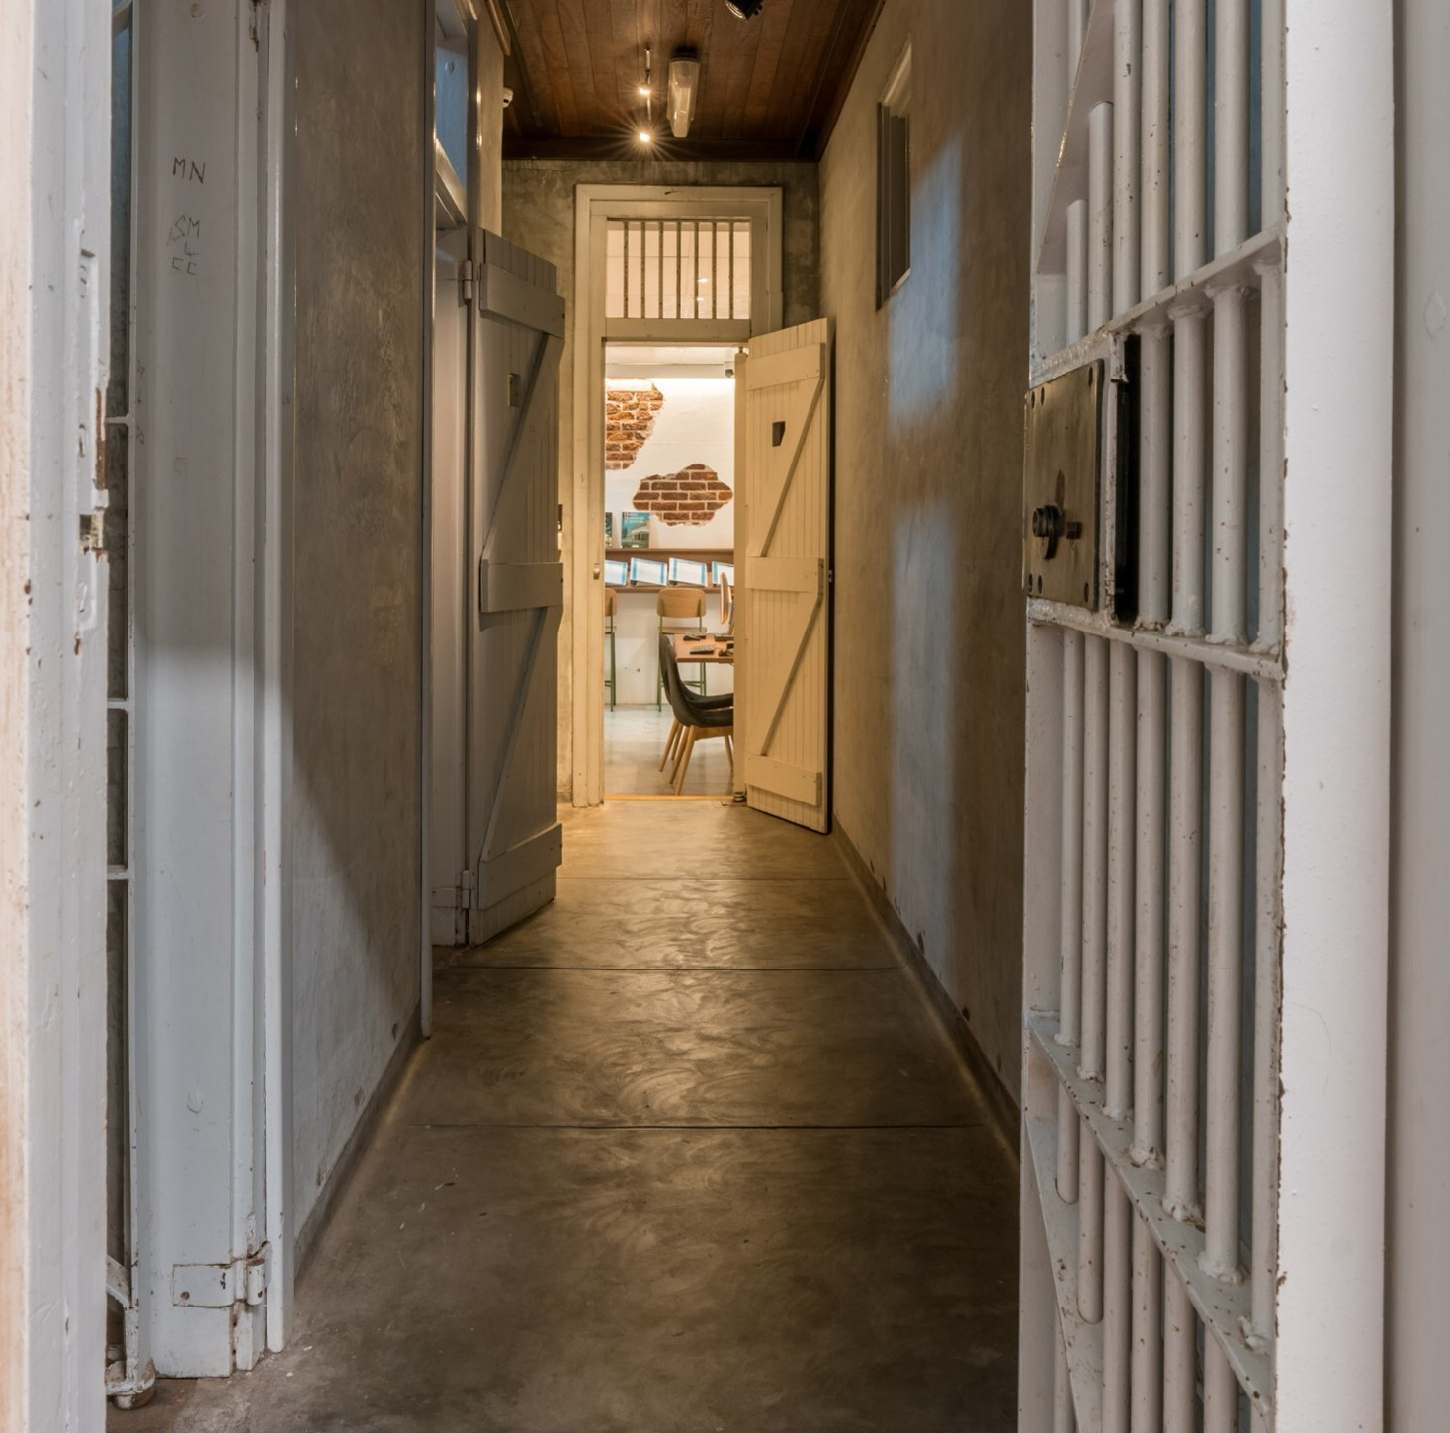
Accessibility
Most areas are wheelchair accessible.
The jail cell is not wheelchair accessible because the doorway is too narrow, but I can look inside from the entrance.
The courtroom has steps, but I can see the objects and displays from the top level.

Slide 11
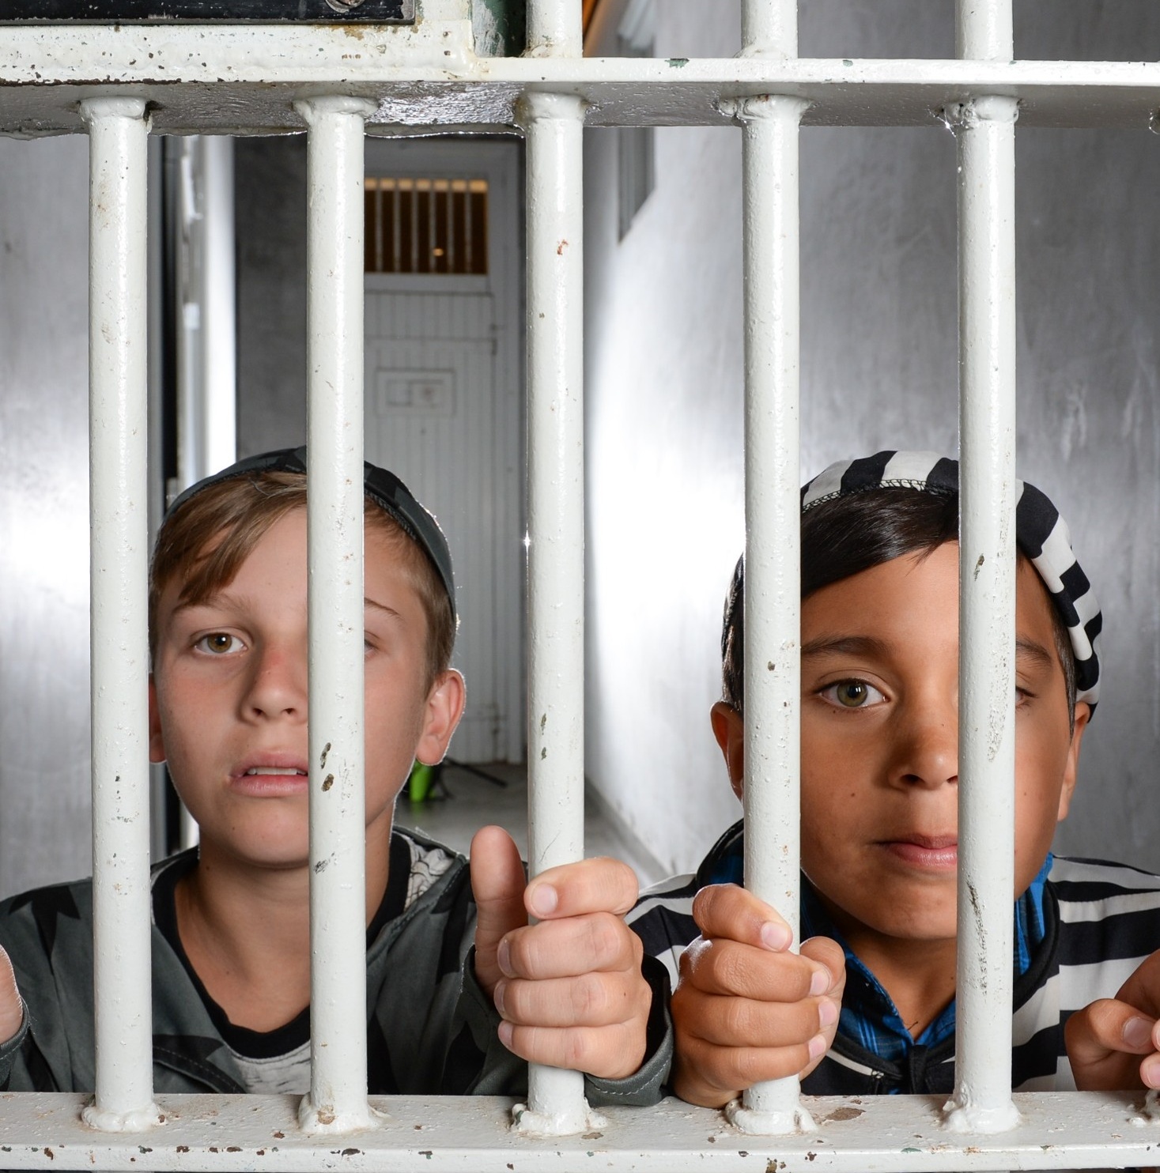
Jail Cell Corridor
When I walk down the corridor, I will see two jail cells.
I can:
  • Put on a costume
  • Have a photo taken behind the bars
  • Reveal the hidden scene

Slide 12
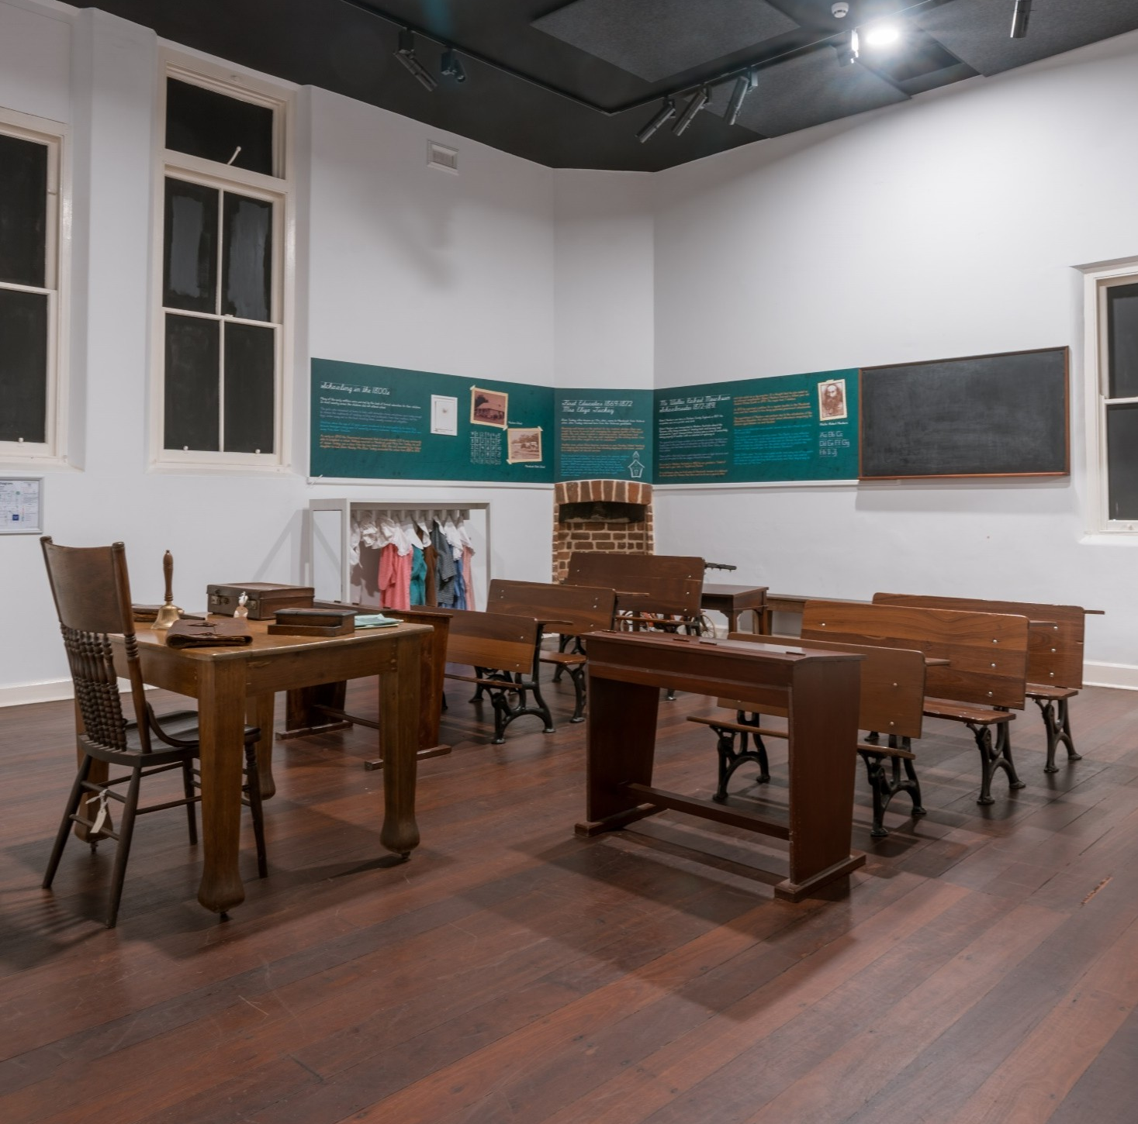
Schoolroom
The Schoolroom looks like a classroom from the past.
I can:
• Put on a costume
• Sit at wooden desks
• Watch a video showing children going to school

Slide 13
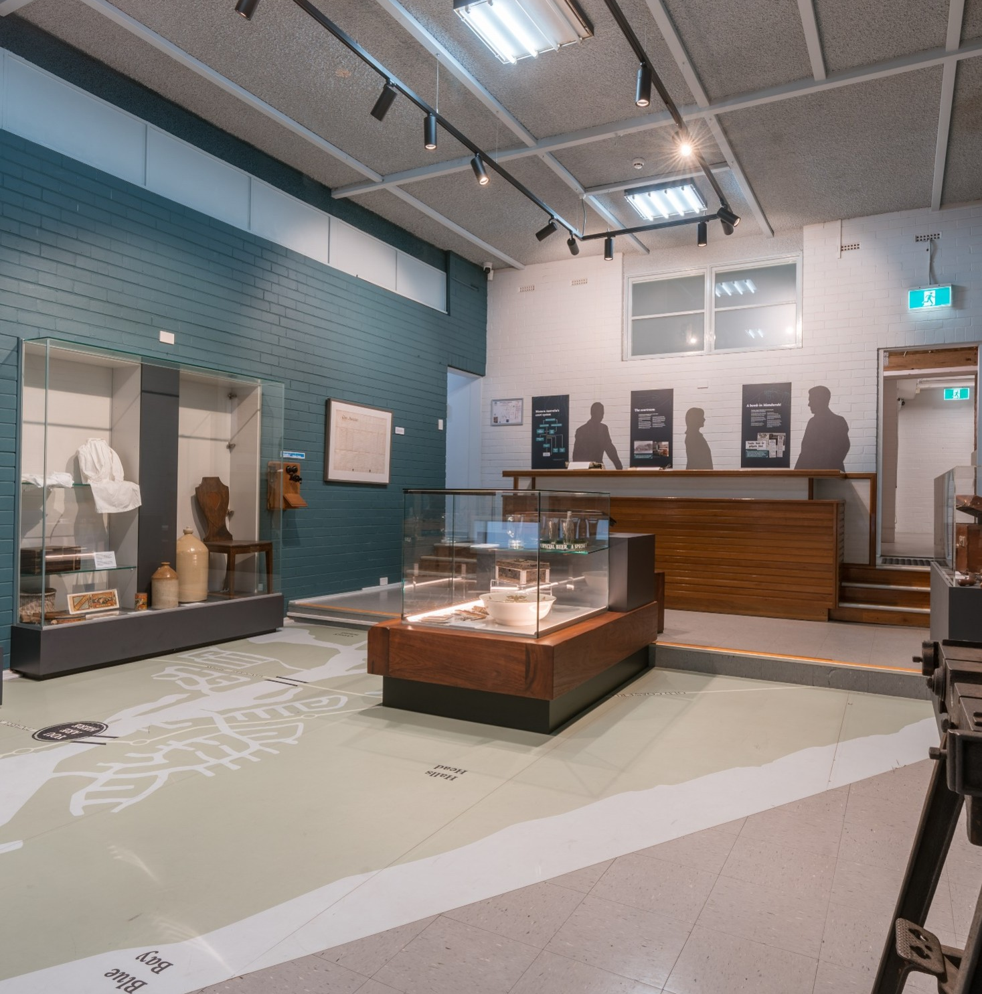
Courtroom
I can see many old objects.
Objects I can touch have a special label.
I can:
• Pretend to use an old telephone
• Type words on a typewriter
• Play a game on a tablet
• Listen at the listening post

Slide 14
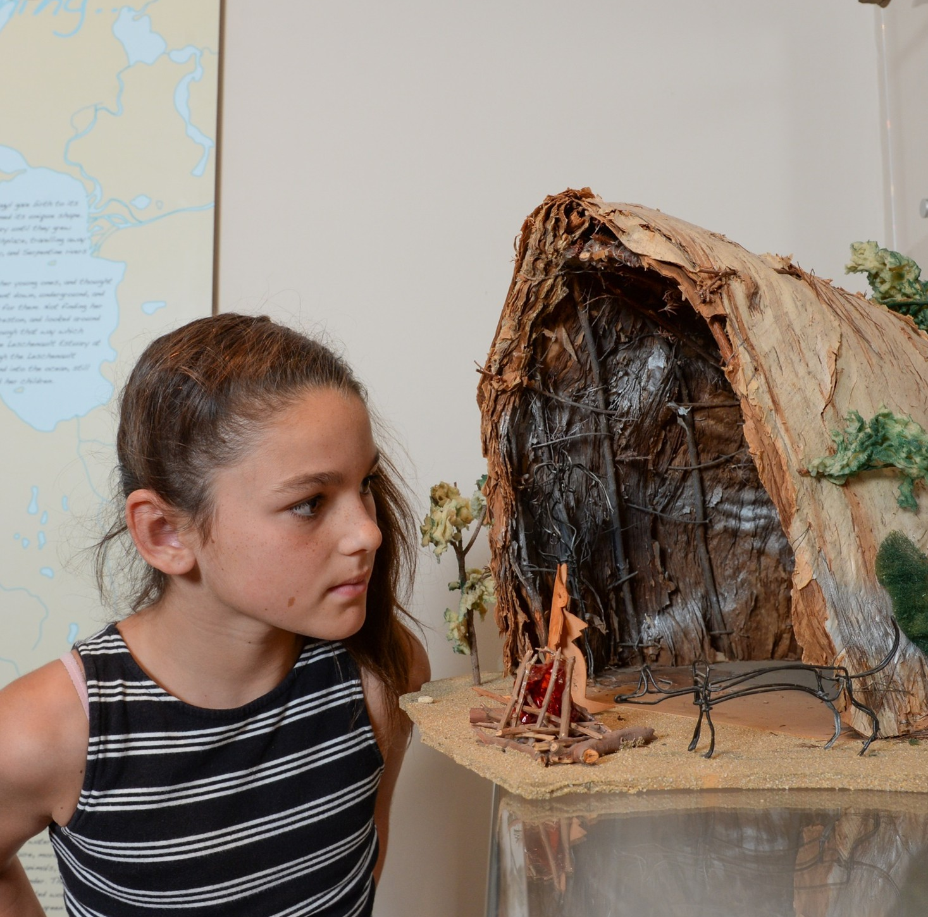
Mandjar Gallery
I will see:
• A replica Aboriginal Mia Mia, a shelter used for sleeping
• Some traditional Aboriginal tools and weapons

Slide 15
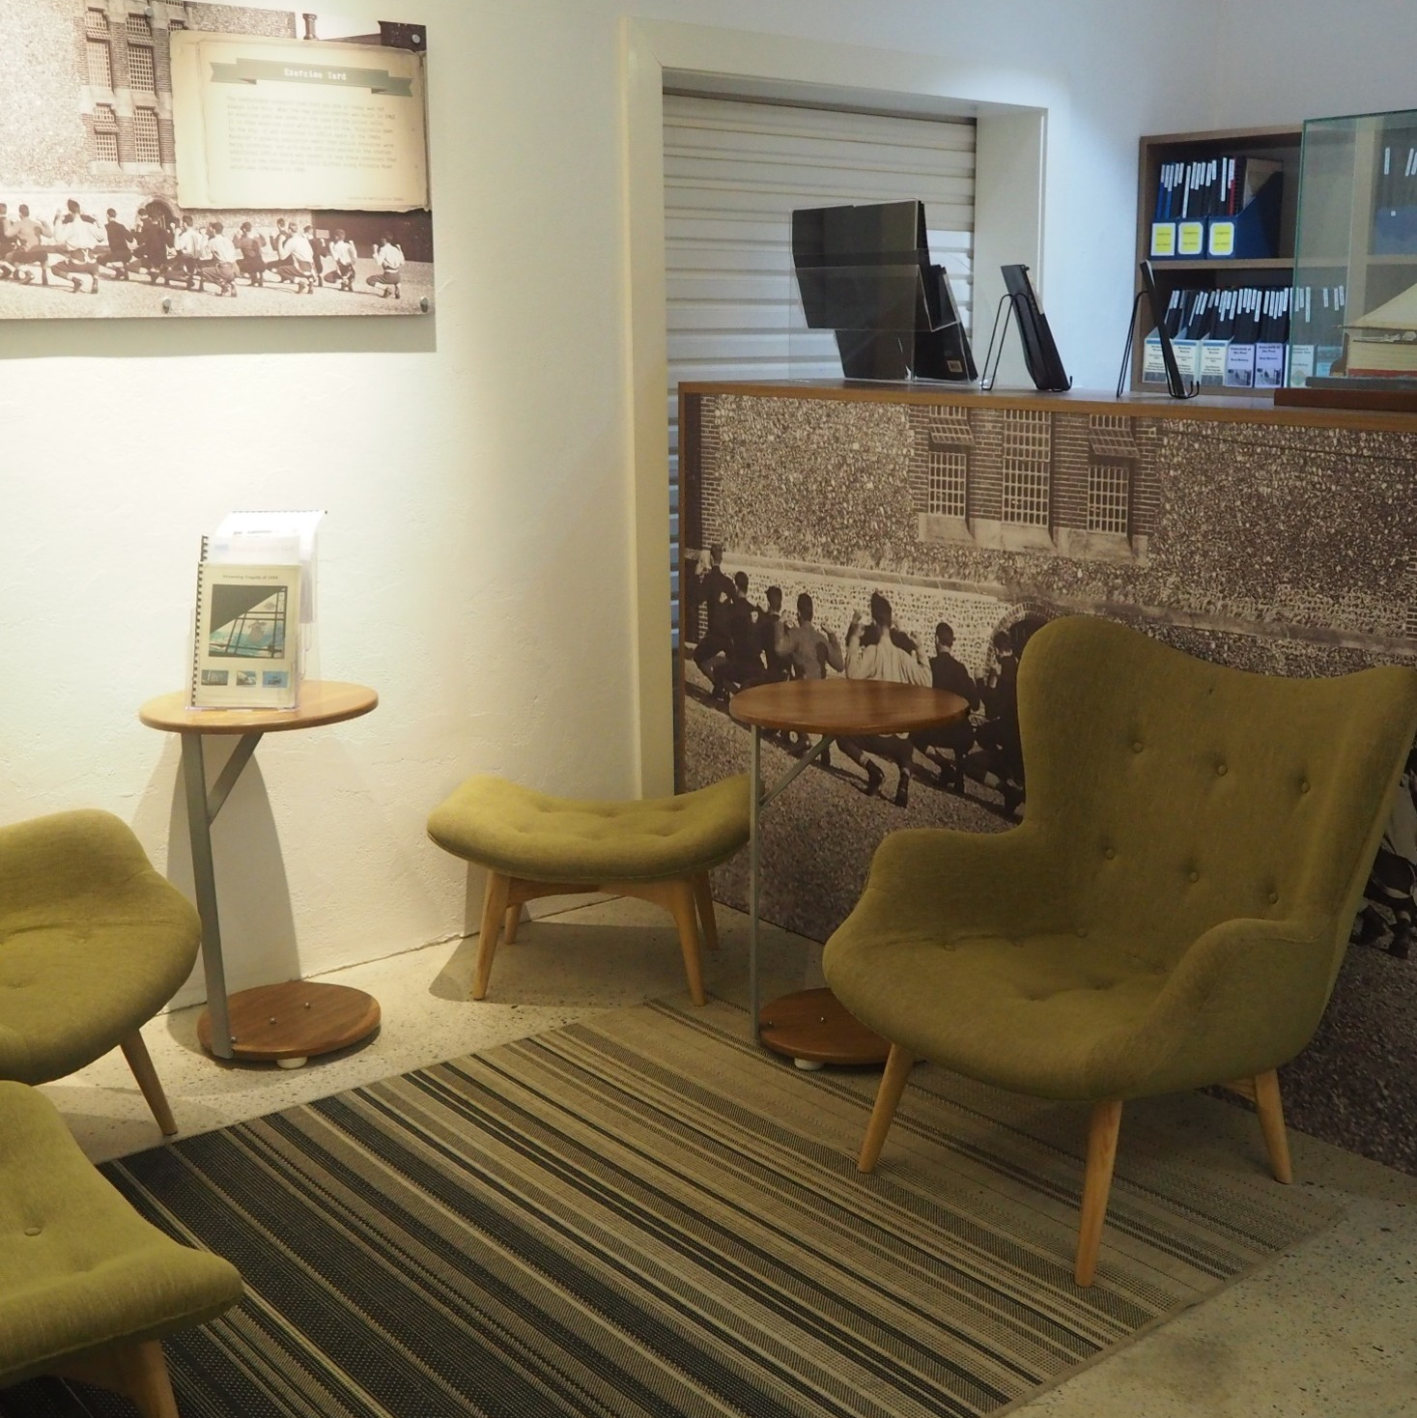
Quiet Time
The Local Studies Area is a quiet space if I need a break.
I can sit in comfortable chairs, read history books, use computers to do research, or watch the TV to learn about history.

Slide 16
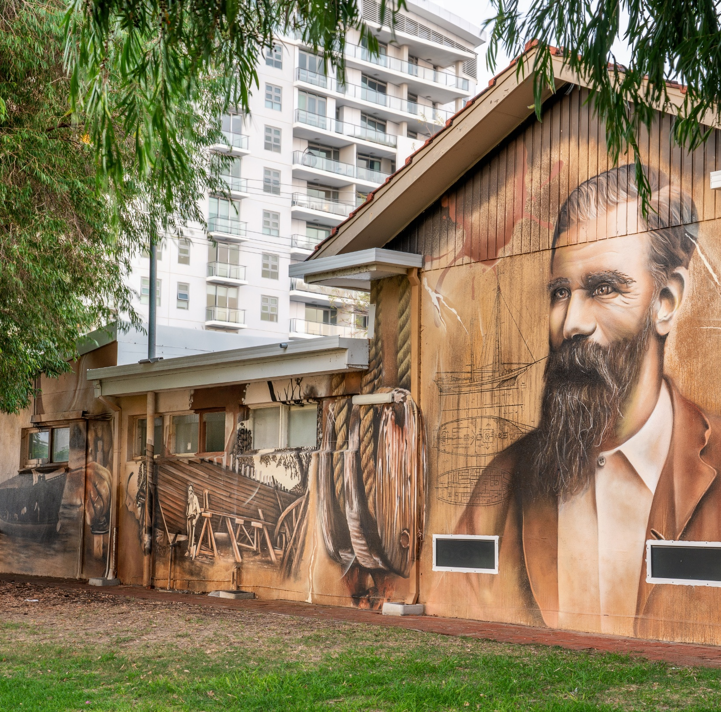
I am ready!
I am now ready to enjoy my visit to Mandurah Museum!

Slide 17
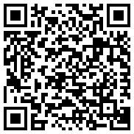

Contact
City of Mandurah
PO Box 210, Mandurah WA 6210
council@mandurah.wa.gov.au
Mandurah.wa.gov.au
9550 3777
The National Relay Service (NRS) assists people who are Deaf or have difficulty hearing or speaking on the phone, offering various call services tailored to different needs and preferences.
For more information visit: accesshub.gov.au
Scan code for more information about access and inclusion at the City of Mandurah.

